Slide 1
Pavement Defects Detection Based on Yolov5 and Generative Adversarial Network
DSPS Conference 2022
Group Members:
Tianjie Zhang,
Steven Kim,
Amanda Mullins,
Yang Lu
Mar. 23, 2022
Notes:
Hello everyone, and thank you so much for having us at this year’s 2022 DSPS Competition. We are with Boise State University, this is TJ Zhang. Our group members include Steven Kim, Amanda Mullins and yang lu. We are here to present our findings from our ‘Pavement Defects Detection Based on Yolov5 and Generative Adversarial Network’.

Slide 2
Overview
Introduction
Data
Methodology
Results
Conclusion
Notes:
The overview of our presentation can be seen here. We will discuss a brief background of pavement distress detection, the data of this project, the methodology, results, then conclude with a brief summary.

Slide 3
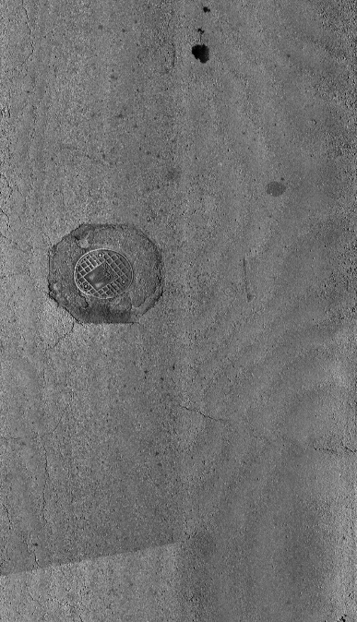
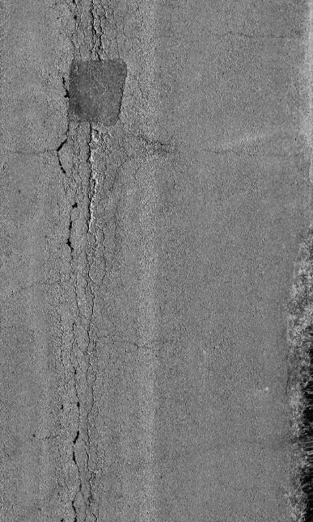
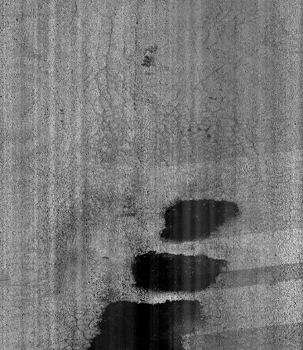
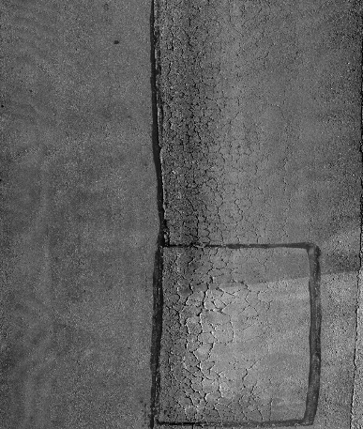

Introduction
Pavement distresses:
Cracking
alligator
transverse
block
longitudinal
Patching
Sealing
Manholes
Pavement Distress
From: DSPS22
Intelligent pavement detection
and identification becomes a significant task.
Traditional inspection: Time-consuming, Labor-intensive, Dangerous, Affect Traffic
Notes:
First, let me introduce the background of this project.
There are several different pavement distresses, such as various cracks, patching, sealing, that occur over the course of a pavement’s service life and can negatively impact the performance and longevity of the structure lifespan. These distresses can occur as a result of loading, environmental conditions, chemicals, and materials used.
The traditional method to determine the number, type, and distribution of defects is often achieved by engineers identifying and counting them manually. However, this method is time consuming, labor intensive and also sometimes dangerous, as it affects the traffic.
A promising new field of interdisciplinary work with computer science being applied to the civil engineering industry, is intelligent pavement defect inspection and identification. If this method is implemented correctly, it could be utilized to identify pavement defects, the severity of the distress, and implement repairs; all through nondestructive methods.

Slide 4

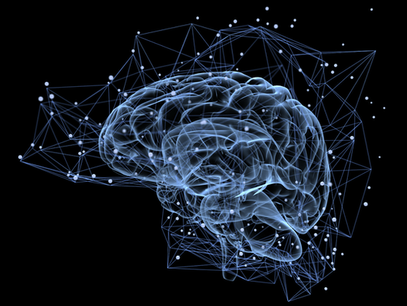
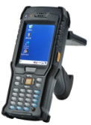
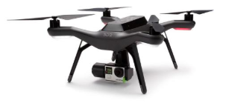

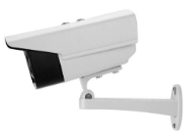
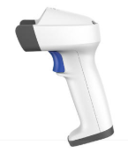
Introduction
Machine Learning Conventional methods deep Learning
K-Means RF SVM Threshold Edge Yolo CNN GAN
Accurate
Pavement Distress Detection
Robust
Auto
Data
Notes:
And intelligent pavement defect detection is currently a hot topic for civil engineering research. The main methods to detect deterioration in roads can be divided into three categories.
The first is conventional methods, such as threshold segmentation and edge detection. They are all computationally efficient, but perform poorly in terms of robustness, as it easily fails when it encounters illumination changes or irregular shaped defects.
The second is Machine learning methods, such as support vector machines and random forest, which can achieve better accuracy than conventional methods when facing new situations during road inspection. However, feature engineering, which heavily depends on the engineer's knowledge, may limit the overall performance.
The third is Deep learning methods. It is becoming one of the most advanced pixel-level target detection methods in road condition inspection. Many methods like CNN and YOLO have good applications in the transportation infrastructure management field. However, it requires a vast amount of pavement damage images to achieve accurate network training.

Slide 5
Data
From: Organizers of DSPS22 (Kansas city, Jefferson city, Columbia, Missouri)
Distress: 7 main distress types
Resolution: 2011×1014 pixels
Annotation: The second release data was annotated by our team members while the first release was annotated by Sponsor.
Limits:
1. The amount of training and validation data is small for a deep learning model.
2. The pavement distresses in test data is unbalanced.
Notes:
Now coming back to the scope of this competition, the mission is to increase the accuracy of the YOLOv5 deep learning model when applying it to pavement distress detection.
First, let’s review the data provided by the organization.
The data was provided to us from the organizers of DSPS22, and was collected from three cities; Kansas city, Jefferson city, Columbia in Missouri. It contains 7 main distress types we have mentioned previously, including 4 kinds of cracks, manholes, sealing and patching. The resolution is 2011 multiple 1014 pixels. And the data was released by the DSPS committee three separate times.

Slide 6
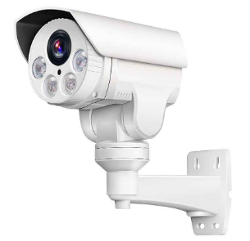
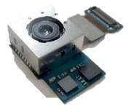

Data
Training
Validation
Testing
The first release
211 annotated
52 annotated
The second release
112 unannotated
28 unannotated
The third release
320
Notes:
The first release contained 211 images for training, and 52 images for validation. In this first dataset release, all the images had been annotated by the sponsor. The second release contains 112 images for training and 28 images for tuning, however, these images were not annotated. This second dataset was annotated manually by our team, which included marking and identifying the distress type and location for each image. Thus, the logic in annotating these distresses are different, as the determination of defects can have quite a bit of variation between people. As a result, this may cause a decrease in test accuracy. As we know, there should be many engineers who will annotate the road images. Each person has his/her own understanding of the defects, this is considered as bias. So, by introducing the second released data into the dataset, then using this to train the YOLOv5 model, the robustness of the model would be improved a lot. The third release are for testing. Sorry I make a mistake here in the number.
However, as we can see, there are two limitations given the provided dataset. The first is the amount of images. The total training dataset only contains 323 images which is quite small when using this deep learning model. The other limitation is the test data. The distresses identified in test data are not evenly distributed, which will cause an unbalanced problem.
For example, if manholes are the main distress type found in the test data. That means if I change the model’s preference to manhole. We will finally get a good model for this task, although it may not fit well for other upcoming images that exhibit other distress types.

Slide 7
Methodology
Pavement images
Preprocess
Training
Yolov5
Testing
GAN
Annotation
Validation
Organizer
Team
The overall procedure
The goal is to train the pavement distress detection model Yolov5, allowing it to learn the features of pavement distresses, and target the objects in top-down view images.
Notes:
Next, let me introduce our work and methodology. Firstly, our primary goal is to improve the accuracy of YOLOv5 when it targets the objects in top-down view images. Furthermore, because it is a data-centric competition, the model can not be fundamentally altered. So the red part is our main contribution, which includes image preprocessing, generative adversarial network , and manual annotation.
First, the raw pavement images were processed by image preprocessing methods.
Next, the given images would be used as an input to the GAN (generative adversarial network), to produce fake images. The produced images and real images would be combined together as the input of the YOLOv5 model to detect the distress on the pavement surface.

Slide 8
Methodology
Purpose
Apply
YOLOv5
Pavement
Data-centric statistics
Data Cleaning
Annotation
Augmentation
Strategies
Preprocess
Increase Bias
GAN
Gaussian Filter
Histogram equalization
Annotate by different people
Normalization
Notes:
So why did we try these methods?
It is Based on the competition's data-centric statistics concept. The conference requested that we mainly focus on the data cleaning, annotation, and augmentation.
For the data cleaning portion, due to the amount of images being quite low, we attempted to use the image preprocess method to denoise the raw images. Three methods including Gaussian Filter, Histogram equalization, and Normalization methods were applied to this work. For the annotation part, our solution is to increase the bias to improve the YOLOv5’s robustness. Finally, for the augmentation part, we introduced the GAN in order to increase the amount of the images, as lack of image has always been a problem in deep learning models.

Slide 9
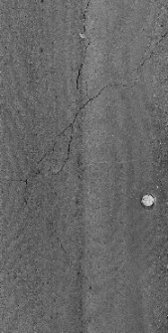
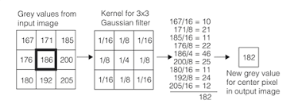
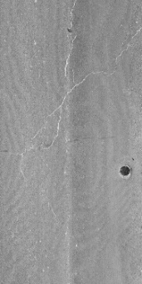
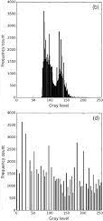
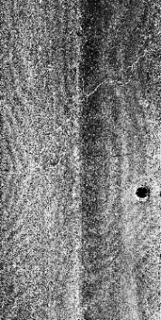

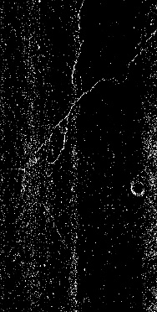
Methodology
Preprocess
Gaussian Filter
Mean subtract
Histogram equalization
Normalization: To make the pixel mean equal to zero
Notes:
Now, Let me introduce the image preprocess part. As we know, raw pavement images are negatively impacted by pulse interference, and something like this, to create ‘noise’ for the model, which distracts it from the actual crack area on the surface.
In order to mitigate or ‘denoise’ this occurrence, a Gaussian filter is applied to the images. Gaussian filter applies a gaussian kernel to each pixel and results in a new value. Through this method, the image is smoother and some of the noise would be removed.
In addition to this, histogram equalization is used to enhance the defects illustrated in the image and make it more recognizable to the model, as seen in the image. This method usually increases the global contrast, especially when the pavement image is represented by a narrow range of intensity values.
Finally, image normalization is used to make the whole image mean equal to zero. We calculate the mean of all pixels in the image. Then for each pixel, the mean value is subtracted. Using this method, the majority of the normal image part would be removed, and only the distresses would remain. Thus, this is also a good way to remove the noise.

Slide 10
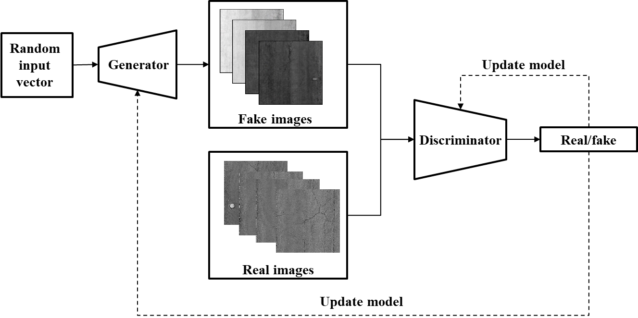
Generative adversarial network (GAN)
A class of ML frameworks
Contains two neural networks (G and D) contest with each other
I. Goodfellow et al., "Generative adversarial nets," Advances in neural information processing systems, vol. 27, 2014.
Notes:
Next, is the generative adversarial network, or GAN method. First, what is GAN? GAN is a class of machine learning frameworks. It contains two neural networks, known as the generator and discriminator. As we can see from its name, the generator is used to produce fake road images. Then, the fake images and real images are mixed together and input into the discriminator. The discriminator is used to determine if the image is fake or real. As you can imagine, it is a battle between the generator and discriminator. The generator would try its best to produce images as real as possible, while the discriminator tries its best to discredit the fake and real images as accurately as possible. Finally, when it reaches some point, such as the error being smaller than the value we set. As a result, we can get the realistic images from the generator.

Slide 11
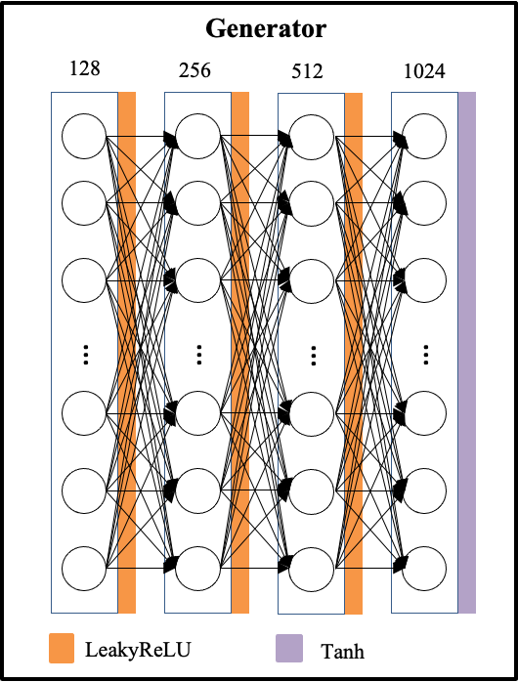
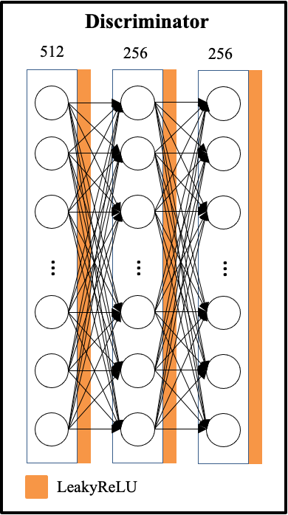
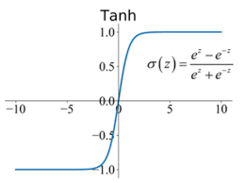
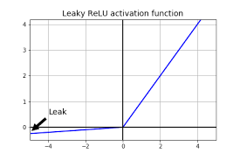
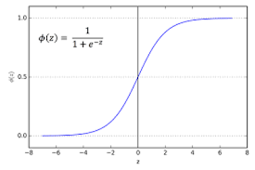
Methodology
Generator:
Deep Neural Network with four hidden layers.
Discriminator:
Deep leaning network with three hidden layers
From: google
Notes:
Both the generator and discriminator consist of a deep neural network. The generator has four hidden layers and the nodes are 128, 256, 512,1024 separately, the output layer has the same size of the image size. Between the hidden layer the activation function was leakyRelu and Tanh. For the discriminator, it has three hidden layers as well, the nodes are 512,256,256, and the output is one node, as real or fake. Then the actual class of the image will be compared with the result from the discriminator. This comparison will be used to update the parameters in discriminator and generator.

Slide 12
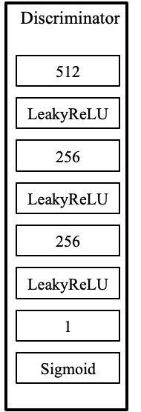
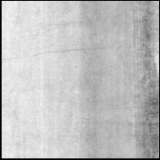
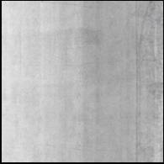

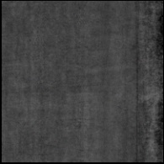
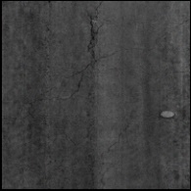
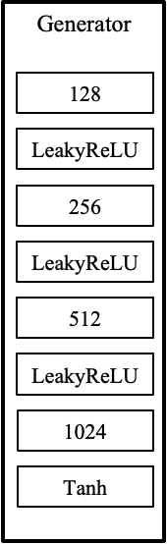
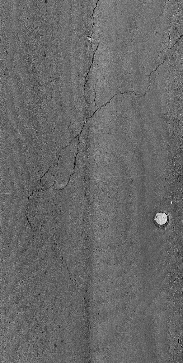
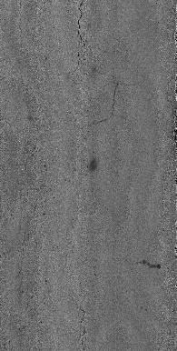
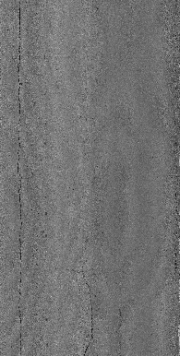
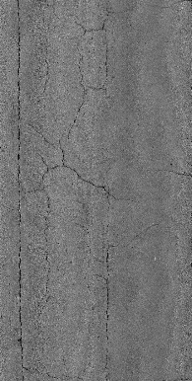
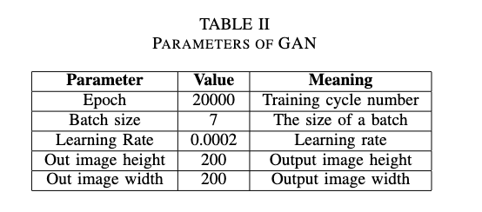
Methodology
Random input vector
8 : 2
Fake images
Update
model
Real images
Real/fake
Update model
Notes:
So, this is the model structure which we used in this work. The epoch we train is 20,000 iterations. The batch size is 7 which means each train epoch, 7 images would input and 7 images would output. And the learning rate is 0.0002. the output image height and width are all 200 pixels. And the loss function is BCEloss （binary cross entropy between target and input）.
Next, after training, 100 images were selected from GAN to increase the amount of images in the dataset. Depending on the ratio of the given training and tuning data, we divided 100 images into 80 and 20.

Slide 13
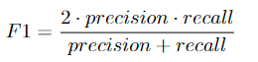
Methodology
The algorithms were implemented in Python, and the GAN method was computed under the following machine speculations: Windows 10, AMD Ryzen 7 3700X, GTX 1080 Ti, 16 GB RAM.
DSPS Given Evaluation Metrics
The result is evaluated by F1 score. The F1 metric weights recall and precision equivalently, acting as a good retrieval algorithm, maximizing both precision and recall simultaneously.
Notes:
The algorithms were implemented in Python, and the GAN method was computed under the following machine speculations: Windows 10, AMD Ryzen 7 3700X, GTX 1080 Ti, 16 GB RAM.
For the evaluation metric, the DSPS let us use F1 score to evaluate the model. The F1 metric weighs recall and precision equivalently, acting as a good retrieval algorithm, to maximize both precision and recall simultaneously.

Slide 14


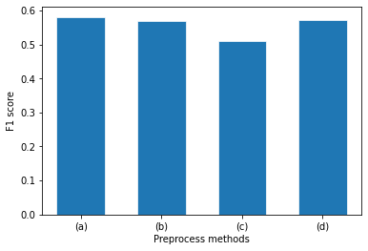
Results
Preprocess
The F1 score decreases after applying the preprocess methods.
Image preprocessing may not be considered.
(a)
(b)
(c)
(d)
Raw image: 0.581
Gaussian Filter: 0.569
Histogram equalization: 0.509
Normalization: To make the pixel mean equal to zero: 0.570
Notes:
Then for the result. For the image preprocess part, we apply Gaussian filter, histogram equalization and normalization to the raw images, and this is a demo for the processed result. As we can see, the gaussian filter smooths the whole picture, the histogram equalization makes the overall contrast more strong, and the normalization removes the majority of the background. However, when we apply each method to the overall procedure, the F1 score from the YOLOv5 model is shown in the figure. Ultimately, we can see that after applying preprocessing methods, the final F1 score decreased.
To analyze why accuracy decreased, we can consider the tradeoffs from the preprocessing methods that negatively impact the dataset. The Gaussian filter narrows down the boundaries between defects and background, thus reducing the accuracy. The histogram equalization sharpens the contrast; however, the feature of the non-defect area would widen, impacting the accuracy of the model. Subtracting the average value in the pavement image removes the background and noise, along with some useful features from the distress. Thus, image preprocessing in this task may not be considered a wise decision.

Slide 15
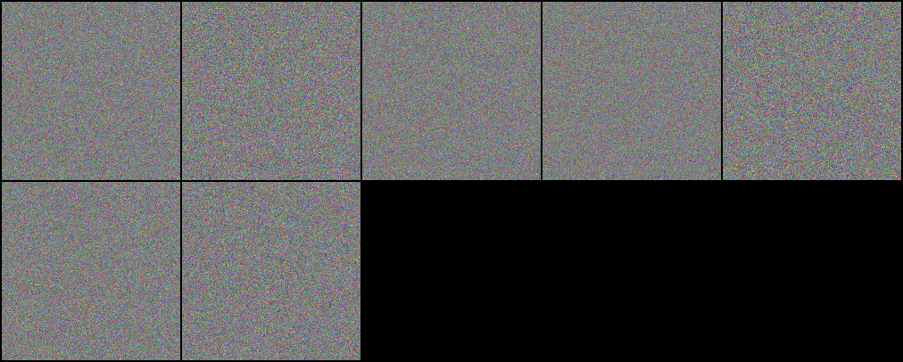
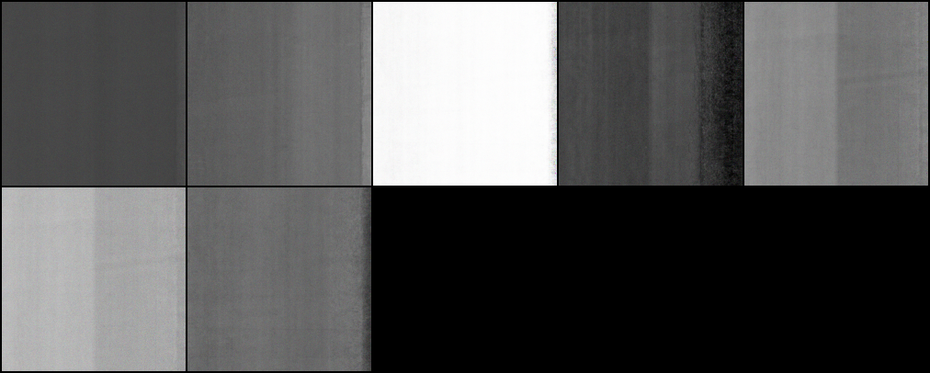
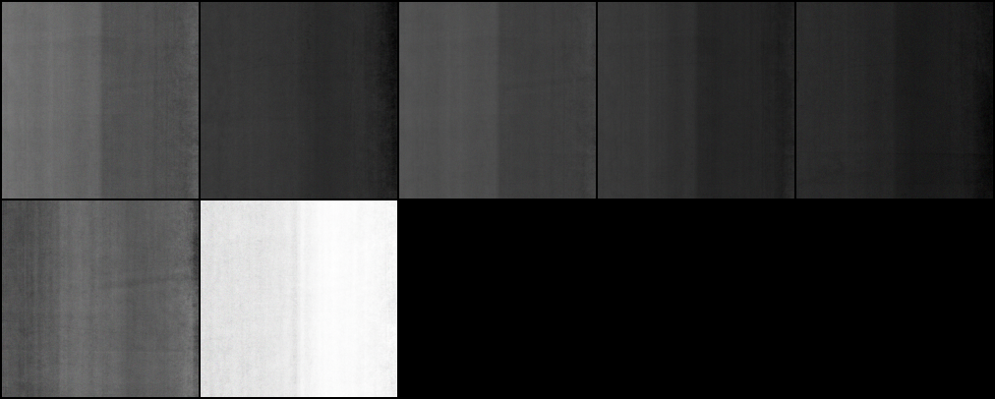
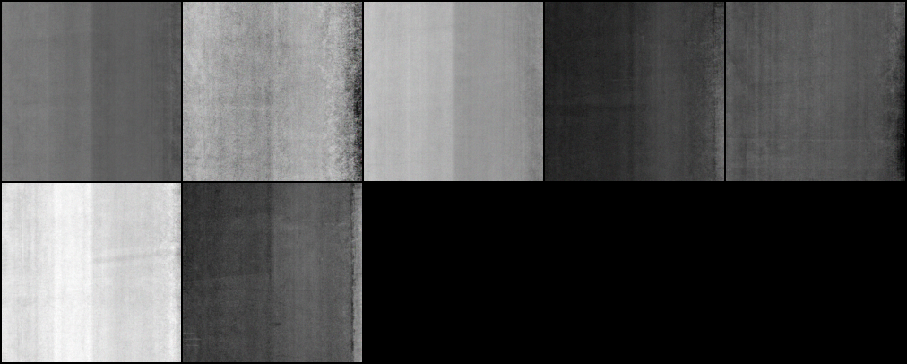
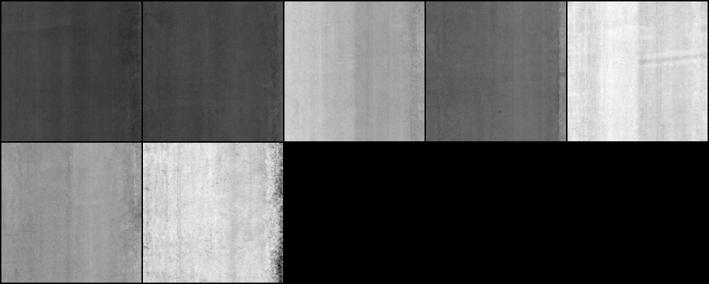
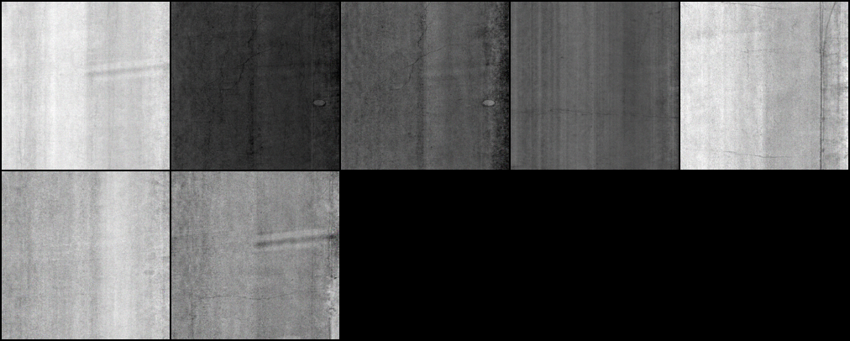
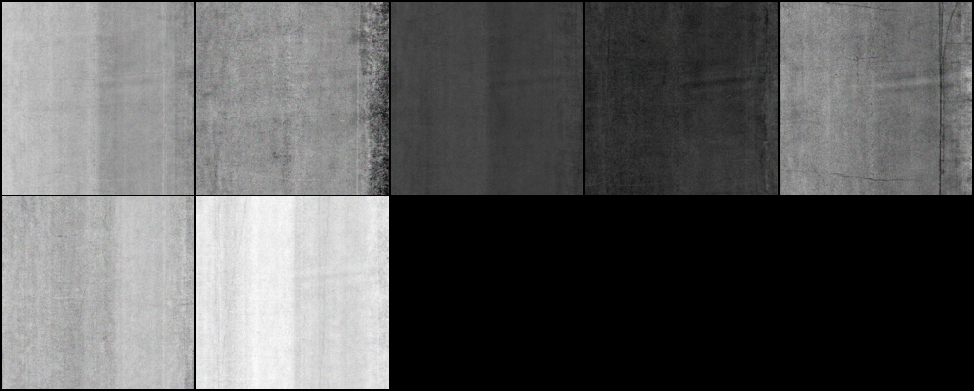
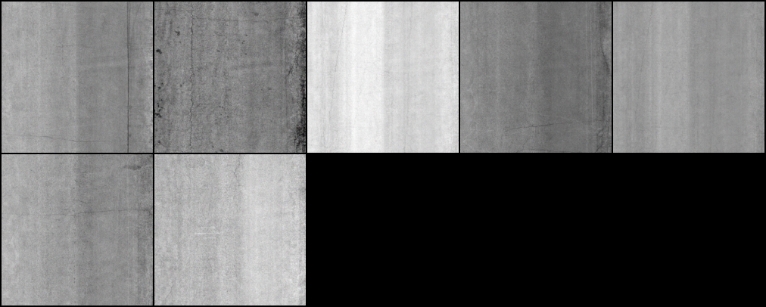
Results
GAN
It take about 12 hours to run the GAN.
Finally, 100 images were chosen to use in the YOLOv5 model.
0
20000
40000
60000
80000
100000
120000
140000
Notes:
To improve the model's F1 score, increasing the size of the data set becomes the most optimal choice. Thus, we use GAN to produce real-like images in order to increase the amount of images in the dataset.
In the GAN portion, we trained about 20,000 iterations. The batch size is 7. 1 picture was chosen from each 20,000 produced images, as we can see in the figure. The first fake image consisted entirely of random noise. However, after around producing 100,000 images, the pavement surface image generated by the GAN model is quite similar to the real image, although the area around the distress is still slightly distorted.

Slide 16
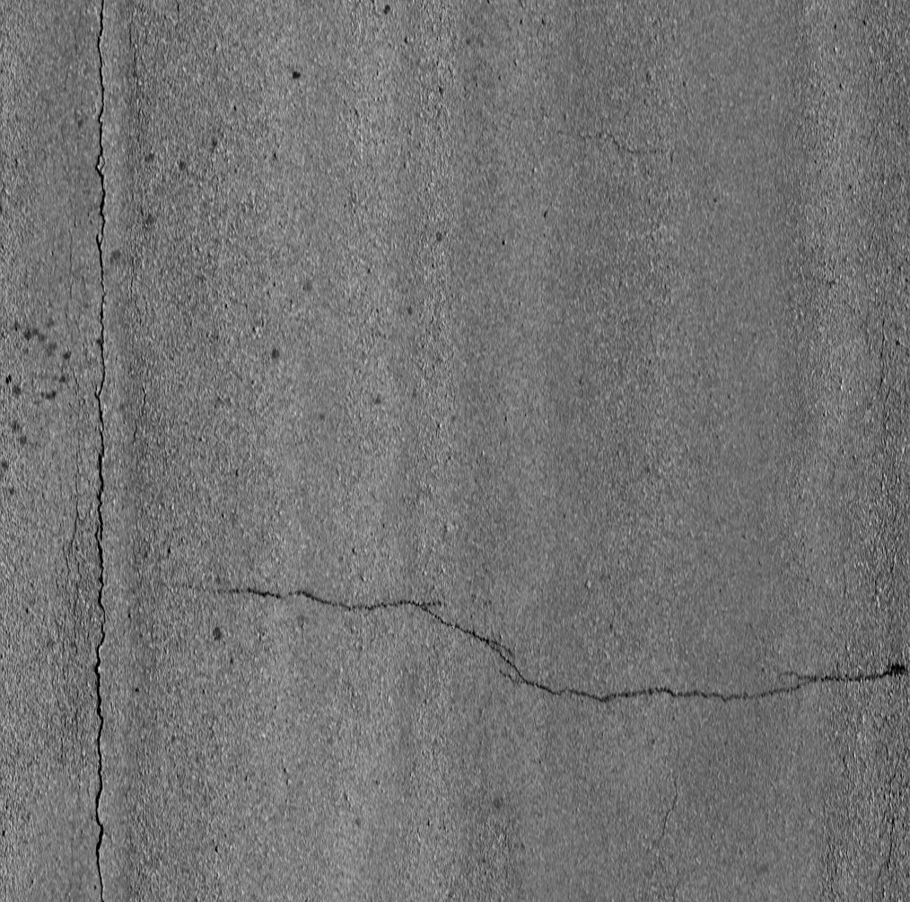
Results
0 epoch
20000 epochs
Real image
GAN
0 epoch: The fake image was consisted of random noise.
20000: The fake image was similar to the real image.
Notes:
We can compare the 140000 produced image and the real image. We can see that the crack texture is very similar to the real crack texture.
Ultimately, 100 fake images were selected from the 140,000 images as another source of data, given that at this stage the fake images generated by the GAN are most real.

Slide 17
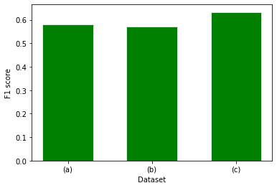


Performance Comparison using DSPS Test Dataset
Overall Process
The addition of fake images brought an increase in the F1 score of 0.633 compared to the raw data accuracy of 0.581.
The first release annotated by DSPS: 0.581
+the second release annotated by team members: 0.576
+the selected 100 fake images: 0.633
Annotation
GAN
Notes:
Next, we test the annotation part. The Yolov5 model was trained and tested by using images annotated by different people. As we can see from the image, (a) is the first release data annotated by the organizer and we use this data only to run the yolov5 model to get the F1 score. Then, (b) ‘s dataset includes not only the first release data, but also the second release data which is annotated by our team. And it shows that the F1 score of the YOLOv5 model dropped slightly. I think the main reason is that people have diverse standards when it comes to annotating images. Thus, the outcome would be affected due to their definition of distress, which explains the small drop in the F1 score. but, self-annotated images are necessary to the training and validation data, since it is considered as a tradeoff between the accuracy and the model's robustness.
Then we want to figure out if the GAN makes sense in the final F1 score. So, we add the additional 100 fake images to the dataset (b). Then, the YOLOv5 was used to predict the F1 score. As we can see from the figure, the addition of fake images brought an increase in the F1 score of 0.633. The improvement is considered significant, compared to the raw data accuracy of 0.581.

Slide 18
Conclusion
1. Image preprocessing methods such as histogram equalization, Gaussian filter and image normalization decrease the F1 score of the test result and are not considered in the overall process.
2. GAN can produce fake images to enlarge the amount of train data. Using GAN to generate more close-to-real pavement images is a cost - effective method.
3. In the overall procedure, based on the YOLOv5 object detection model, the GAN gains its importance in image augmentation and promotes a better result in the pavement distress inspection.
Notes:
In summary, we have several conclusions from our work.
First, Image preprocessing methods such as histogram equalization, Gaussian filter and image normalization ultimately decreased the F1 score of the test result in this dataset, are not considered as a wise decision in this task.
Second, GAN can produce fake images to enlarge the amount of train data, as deep learning is heavily dependent on a large quantity of good quality images in the dataset.
Third, based on the YOLOv5 object detection model, the GAN gains its importance in image augmentation, and improves the F1 score by about 9%.

Slide 19
Future works
1. The neural network of the generator and discriminator is a linear neural network in our work. A convolutional neural network (CNN) would be considered as it is more suitable for images generating.
2.The more pictures, the better results. This is because deep neural network depends a lot on the quality and quantity of images. Thus, we plan to generate more fake images using GAN to increase the accuracy.
3. With more computing power, we can produce bigger and higher resolution images, which will promote the utility and advance of GAN in the Yolov5 model.
Notes:
There are some improvements we could do in our work. The neural network of the generator and discriminator is a linear neural network in the task. A convolutional neural network might be more suitable for image generating. Because it will converge more quickly and the accuracy would be higher..
The other thing we could do is enlarging the image numbers in training data. The more pictures, the better results. This is because a deep neural network depends a lot on the quality and quantity of images. Thus, to generate more fake images using GAN to increase the accuracy would be a wise way.
Third, With more computing power, we can produce bigger and higher resolution images, which will promote the utility and advance of GAN in the Yolov5 model.

Slide 20
Thank You
Any question?
Team:
Tianjie Zhang,
Steven Kim,
Amanda Mullins,
Yang Lu
Boise State University
Email: tjzhang@u.boisestate.edu
Notes:
Thank you for your listening!

